Slide 1
Visualization For: Cognitive Amplification How : Reference Model
Babloo Markose

Slide 2
Topics Already Covered
Topics to be covered
What is External Cognition
Visual Aid to Cognition
Navigation Charts
Diagrams
Meaning of Information visualization
Origin
Examples: Active Diagram, Data monitoring, Information Chromatography
Discussion on Cognitive Amplification
Knowledge Crystallization
Levels of use
Cognitive Amplification(cont.)
Quantifying information visualization: Cost Reduction
How visualization amplifies cognition
Mapping Data to Visual form
Reference model
Data Table
Variable Types
Metadata
Data Transformation

Slide 3
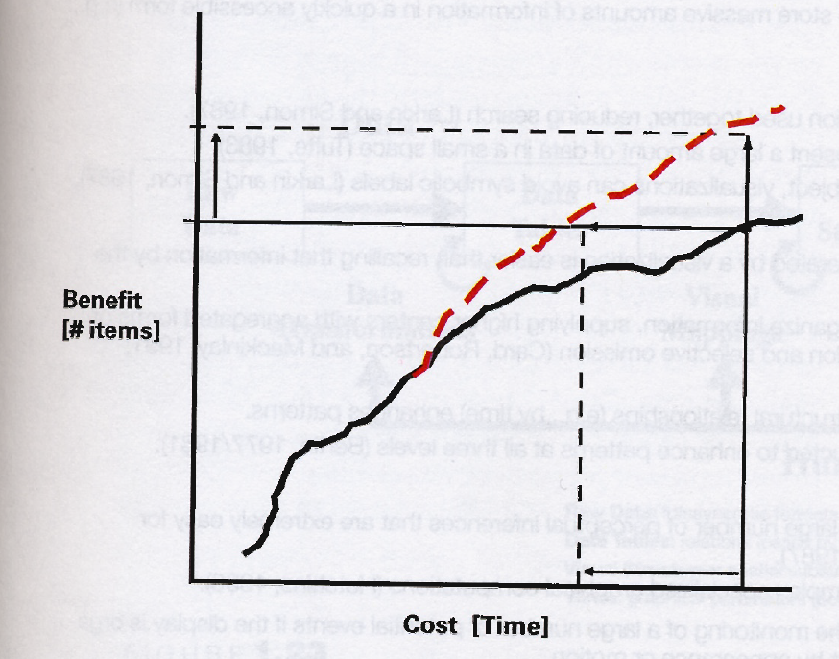
Visualization Cost
Cost-of-knowledge
Every action has a cost
Knowledge crystallization process has cost structure to represent the cost. NOT JUST IN TERMS OF DOLLORS(Think about time, resources etc.)
Benefits of knowledge crystallization as a function of cost is used to quantify and graphically represent it(Cost-of-knowledge-characteristic function )
Evaluating a visualization process
Using visualization : Cost-of-knowledge reduction
Maximize information benefits per unit cost
Will it always reduce cost?

Slide 4
Spiral Calendar vs Sun’s CM
Task: Navigate to another day
Cost Driver: Number of cycles/steps to reach a particular day
Measure :Time for navigation
Plot: Cost/Time(Dependent Variable) against cost driver(Independent Variable)
Findings: Large calendar visualization reduced cost, not for small calendars.

Slide 5
How does Visualization amplifies cognition
Increased resources
Multiplication example using paper and pen vs mental task
885 * 925
885 *
925
4425
1770
7965
818625

Slide 6
How does Visualization amplifies cognition
Reduced Search
Groups related data visually and compact information into small space(Organizational Structure)
Knowledge Crystallization

Slide 7
How does Visualization amplifies cognition
Enhanced recognition of patterns
Consider a table with coordinates of a linear equation
x | y
10 | 8.04
8 | 6.95
13 | 7.58
9 | 8.81
11 | 8.33
14 | 9.96
6 | 6.5
4 | 4.26

Slide 8
How does Visualization amplifies cognition
Perceptual Inference and Perceptual Monitoring
Is a company doing well?(Plot sales against year)
year | sales(k dollors)
2004 | 4.26
2010 | 8.04
2011 | 8.33
2013 | 8.9
2014 | 9.6
2016 | 9.8
2018 | 10.5
2019 | 11
Triangle height = 2(A/b)
But there are different mechanisms for Visualization. How do we determine which visualization to use?
Depends on appropriate mapping of data to visual form.

Slide 9
Reference Model

Slide 10
Reference Model
Transformation
Data Transformations map Raw Data into Data Tables,
relational descriptions of data
include metadata.
Visual Mappings transform Data Tables into Visual Structures, structures that combine spatial substrates, marks and graphical properties.
View Transformations create Views of the Visual Structures
specifying graphical parameters such as position, scaling and clipping.
User interaction
controls of these transformations,
restricting the view to certain data ranges, ex. changing the nature of the transformation.

Slide 11
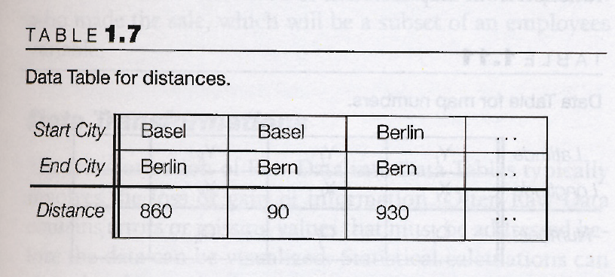
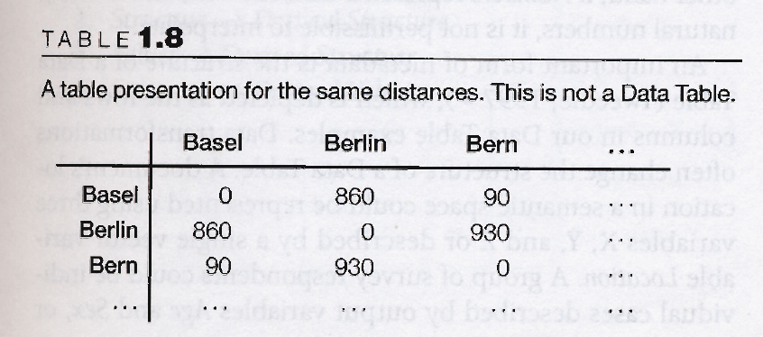
Outputs
Data Table
Brings structure to data
Visual representation of mathematical function
Determines Dimensionality of relation between tables
Choose visual structure
Table, Tuple, Attribute
Unique id for each record
Visual structure
View

Slide 12
Data Table Characteristics: Data Types
Nominal
Category/Names. Can determine equality
Ordinal
Order/Hierarchy. Can determine sets/tuples along with equality.
Quantitative/Numerical
Can do arithmetic operations.
Ex. Geographic, Spatial, Temporal
Importance of data type
Determine the axis for Visual Structure

Slide 13
Data Table Characteristics: Meta Data
Descriptive information of the data in the data table
Gives information on structure of the table
For example data type of an attribute or constraints on values a attribute can take etc.
Data Transformation
Value to derived value (Std. deviation from variance)
Value to derived structure(Sorting)
Structure to derived value
Structure to derived structure

Slide 14
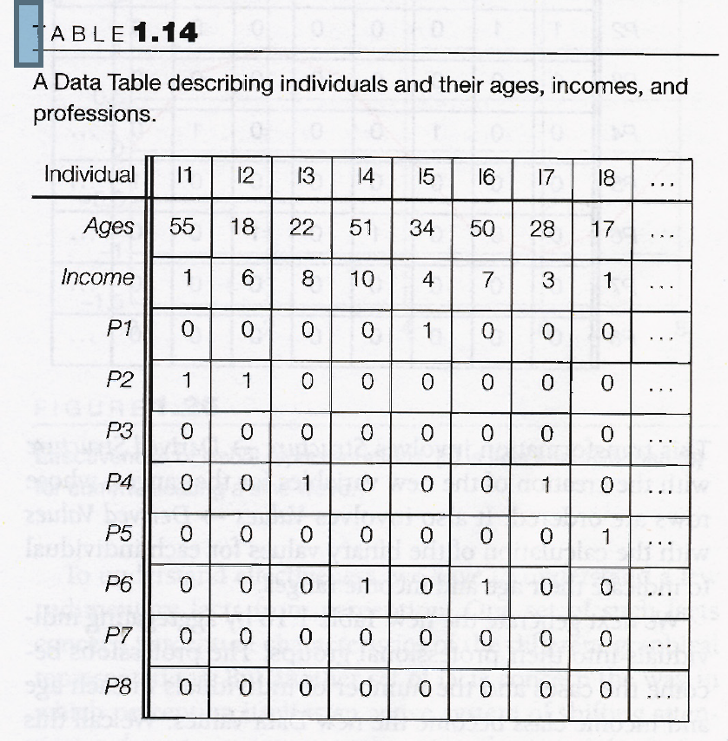
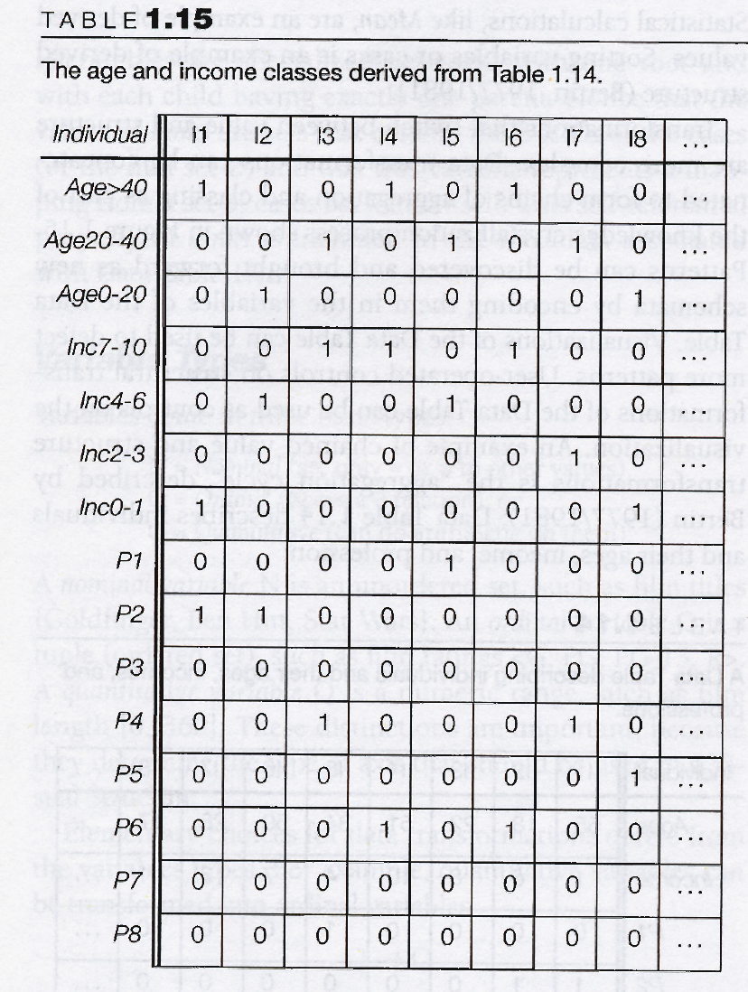
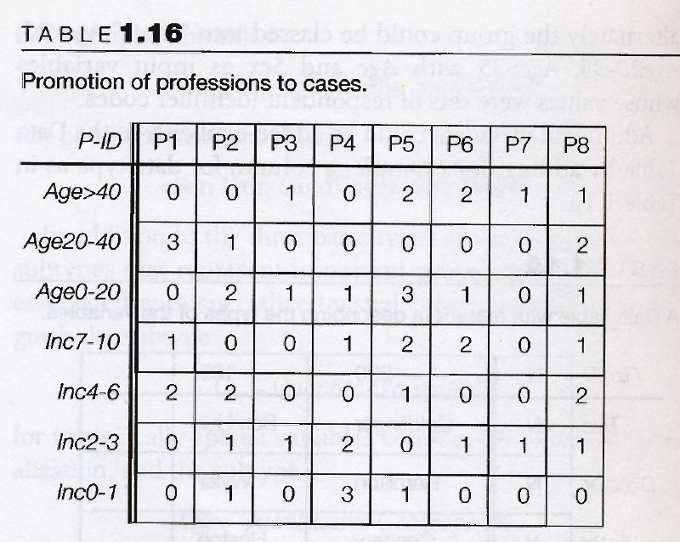
Cases/attributes:- Individuals
Age/Income/Pn:- Tuples
Age to age group: Structure to derived structure
Age numeric value to binary : value to derived value
Tuple converted to attribute:- Promotion, Structure to derived value

Slide 15
Understanding practical application of transformation
x | y
2 | 0.5
3 | 0.25
4 | 0.16666667
5 | 0.125
6 | 0.1
7 | 0.08333333
x | Y1= 1/y
2 | 2
3 | 4
4 | 6
5 | 8
6 | 10
7 | 12

Slide 16
Reference
“Readings in information visualization: Using vision to think”, S. K. Card, J.D. MacKinlay, B. Schneiderman, 1999, Morgan Kaufmann Publishers

